Slide 1
Int 306 dbms
Database Architecture

Slide 3
Schemas, Instances, and Database State
Database Schema
The description of the database
Specified during database design
Expected to change when requirements change
Schema Diagram
Most data models have certain conventions for displaying schemas as diagrams
Displays only some aspects of a schema, such as names of record types and data items
Some constraints are difficult to represent
Schema Construct
Each object in the schema (e.g., student, course)

Slide 4
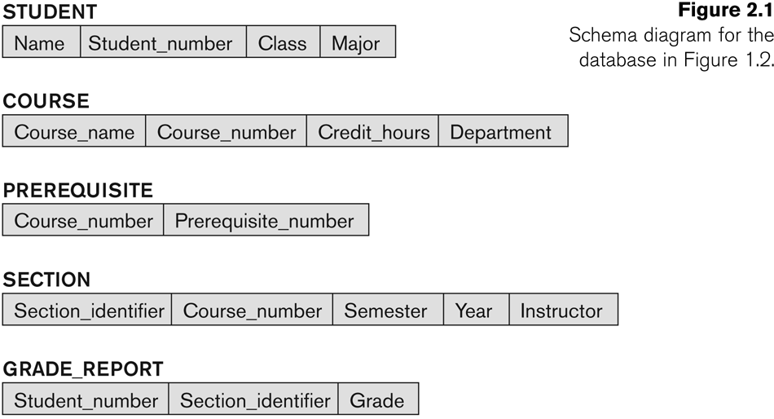
Example

Slide 5
Database State or Snapshot
Actual data in the database may change frequently
The data in the database at a particular moment in time is called a database state or snapshot
Also called the current set of occurrences or instances in the database

Slide 6
Database Schema vs. Database State
The distinction is very important
When we define a database, we specify its database schema only to the DBMS
Database state is the empty state (w/ no data)
Initial state: when the database is first populated or loaded with initial data
Current State: State at any point in time. Every time an update operation is applied to the database, database state changes

Slide 7
Database Schema vs. Database State
Valid State: A state that satisfies the structure and the constraints specified in the schema
The schema is sometimes called the intension, and a database state is called an extension of the schema

Slide 8
Database Architecture
Defines the structure of the system
Identify the Components
Define function of each component
Inter-relation and interactions between each components defined

Slide 9
Database Architecture
Three types
One Tier
Two Tier
Three Tier

Slide 10
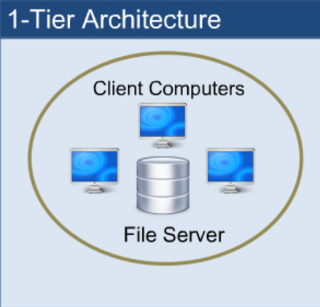
One Tier

Slide 11
One Tier
1 Tier Architecture in DBMS is the simplest architecture of Database in which the client, server, and Database all reside on the same machine.
Any changes done here will directly be done on the database itself. It doesn't provide a handy tool for end users.
The 1-Tier architecture is used for development of the local application, where programmers can directly communicate with the database for the quick response.
Example
A simple one tier architecture example would be anytime you install a Database in your system and access it to practice SQL queries. But such architecture is rarely used in production.

Slide 12
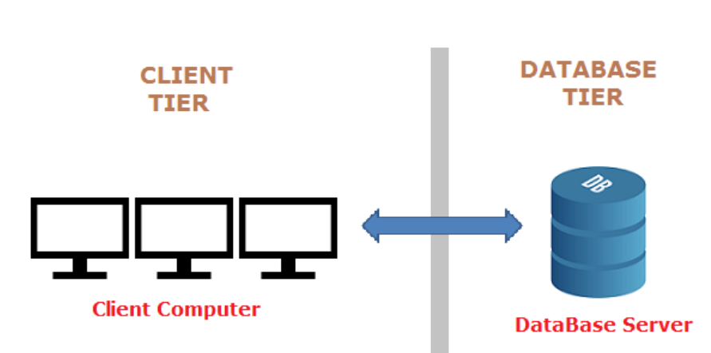
Two-Tier

Slide 13
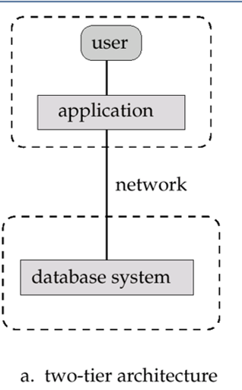
Two-Tier

Slide 14
Two-Tier
The 2-Tier architecture is same as basic client-server. In the two-tier architecture, applications on the client end can directly communicate with the database at the server side. For this interaction, API's like: ODBC, JDBC are used.
The user interfaces and application programs are run on the client-side.
The server side is responsible to provide the functionalities like: query processing and transaction management.
To communicate with the DBMS, client-side application establishes a connection with the server side.
Examples- Clerk in the bank

Slide 15
Advantages of Two-Tier Architecture
Two tier architecture provides added security to the DBMS as it is not exposed to the end-user directly (authorized users only).
It also provides direct and faster communication.
Easy to maintain.

Slide 16
Disadvantages of Two-Tier Architecture
Scalability is not possible.
Risk of authorized users harming the database as they are directly getting access to the database.

Slide 17
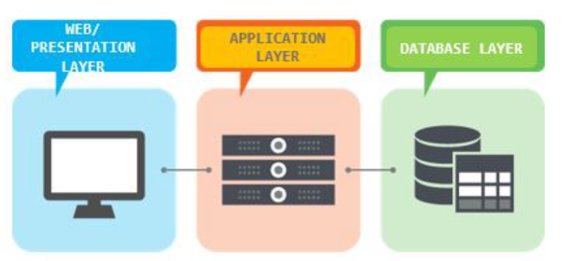
Three tier Architecture

Slide 18
Three tier Architecture
The 3-tier architecture contains one more layer between the client and the server.
In this architecture, there is no direct communication between client and server.
Mainly, the 3-tier is used for large applications on the web.
The features of 3-tier architecture are data backup, recovery, security, and concurrency control.

Slide 19
Three tier Architecture
The Application layer resides between the user and the DBMS, which is responsible for communicating the user’s request to the DBMS system and send the response from the DBMS to the user. The application layer(business logic layer) also processes functional logic, constraint, and rules before passing data to the user or down to the DBMS.

Slide 20
Three tier Architecture
The goal of Three Tier client-server architecture is:
To separate the user applications and physical database
To support DBMS characteristics
Program-data independence
Supporting multiple views of the data

Slide 21
Three tier Architecture
Advantages
Scalability
Security (no direct access to database)
Disadvantages
Maintenance

Slide 22
Three Schema Architecture

Slide 23
Three schema Architecture
The three-schema architecture divides the database into three-level used to create a separation between the physical database and the user application. In simple terms, this architecture hides the details of physical storage from the user.
The database administrator (DBA) responsible is to change the structure of database storage without affecting the user’s view. It deals with the data, the relationship between them and the different access methods implemented on the database. The logical design of database is called a schema

Slide 24
Three schema Architecture
This architecture contains three layers of database management system, which are as follows −
External level
Conceptual level
Internal level

Slide 25
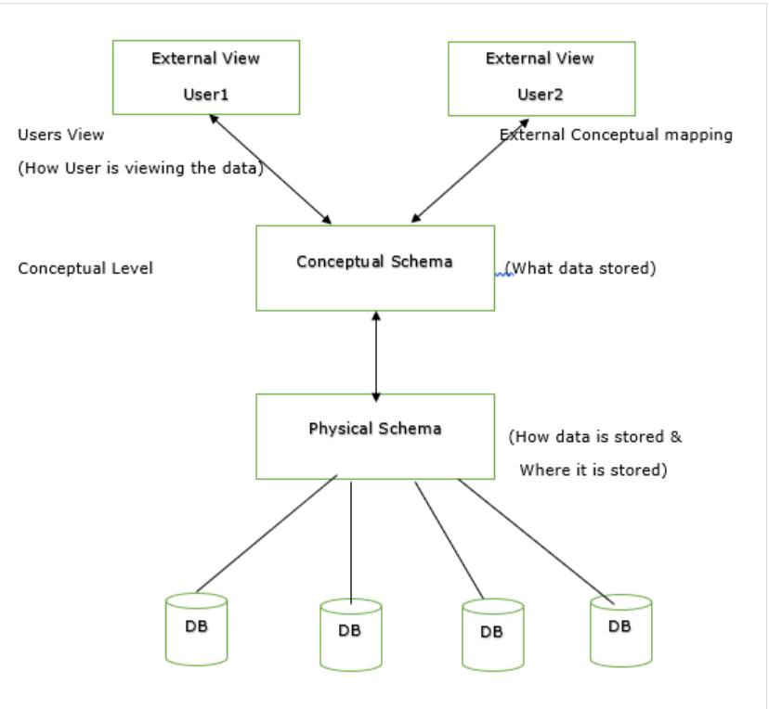

Slide 26
Three schema Architecture
External/ View level
This is the highest level of database abstraction. It includes a number of external schemas or user views. This level provides different views of the same database for a specific user or a group of users. An external view provides a powerful and flexible security mechanism by hiding the parts of the database from a particular user.

Slide 27
Three schema Architecture
Conceptual or Logical level
This level describes the structure of the whole database. It acts as a middle layer between the physical storage and user view. It explains what data to be stored in the database, what the data types are, and what relationship exists among those data. There is only one conceptual schema per database.
This level describes the structure of the whole database. It acts as a middle layer between the physical storage and user view. It explains what data to be stored in the database, what the data types are, and what relationship exists among those data. There is only one conceptual schema per database.

Slide 28
Three schema Architecture
Internal or Physical level
This is the lowest level of database abstraction. It describes how the data is stored in the database and provides the methods to access data from the database. It allows viewing the physical representation of the database on the computer system.
The interface between the conceptual and internal schema identifies how an element in the conceptual schema is stored and how it may be accessed. It is one which is closest to physical storage. The internal schema not only defines different stored record types, but also specifies what indices exist, how stored fields are represented.

Slide 29
Data Independence-Achievement of Layered Architecture of DBMS
Two kinds of data independence:
Logical data independence
Physical data independence

Slide 30
Data Independence
Logical Data Independence: The capacity to change the conceptual schema without having to change the external schemas and their application programs.
Physical Data Independence: The capacity to change the internal schema without having to change the conceptual schema.

Slide 31
Data Independence
The processes of transforming requests and results between the levels are called mappings.
When a schema at a lower level is changed, only the mappings between this schema and higher-level schemas need to be changed in a DBMS that fully supports data independence. The higher-level schemas themselves are unchanged. Hence, the application programs need not be changed since they refer to the external schemas.

Slide 32

Any DOUBT ?

